Slide 1
Airports Authority of India

Slide 2
Table of Contents
Introduction
Overview of Data Security
Data Security Journey for EPFO
Data Encryption
Data Redaction
Notes:
Overview
Demonstration
Introduction to APEX

Slide 3
Data – The World’s Most Valuable Resource
“Information has replaced technology as the central and most critical asset to be managed by organizations. As a result, business leaders must shift to using the value of information as basis for new planning & funding models.”
- Doug Laney, Research Vice President, Gartner.
$430 Billion Advantage to Data Driven Organizations.
Data driven organizations are 23 times more likely to acquire customers, 6x as likely to retain those customers, and 19x as likely to be profitable as a result. ³
Source:
Gartner
IDC
McKinsey Global Institute

Slide 4






Managing Data in Spreadsheets Is Challenging
Data Validation – Manual and error prone
95%
38%
Data Integrity – Cannot guarantee accuracy
of data in multi-user environment
Error Prone Manual Involvement
Outdated / Data Silo
Data Security – Cell locking is ineffective
60%
33%
Data Sharing – Excel is sluggish and hard to share
Ineffective Data Redaction
Too Slow and Too Hard to Share

Slide 5
Demonstration

Slide 6





What Is Oracle APEX?
A low-code development platform that enables you to build scalable and secure enterprise apps with world-class features that can be deployed anywhere.
Develop desktop and mobile web apps
Visualize and maintain database data
Leverage SQL Skills and database capabilities

Slide 7


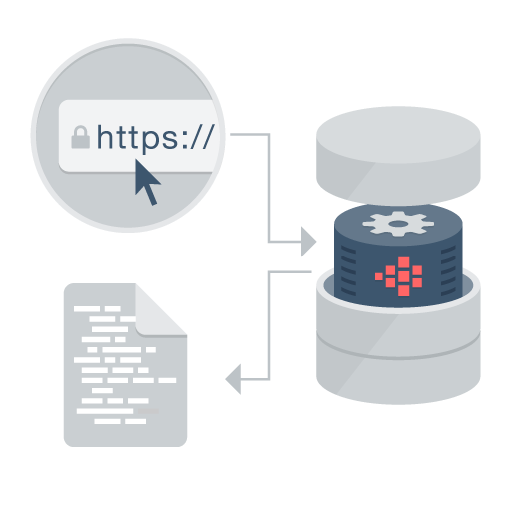

APEX – Distinguishing Characteristics
App Development IDE is a web browser.
App definitions are stored in the database as meta data.
Page generation is efficient with only one request and one response.
Declarative –
No code generation
Data processing done in the Database
No client software needed
Rapidly develop, customize, and deliver
Pre-built controls for security, authentication, database interaction, validation, session management and more…
Go from prototype to production in minutes
Develop
Customize
Deliver

Slide 8
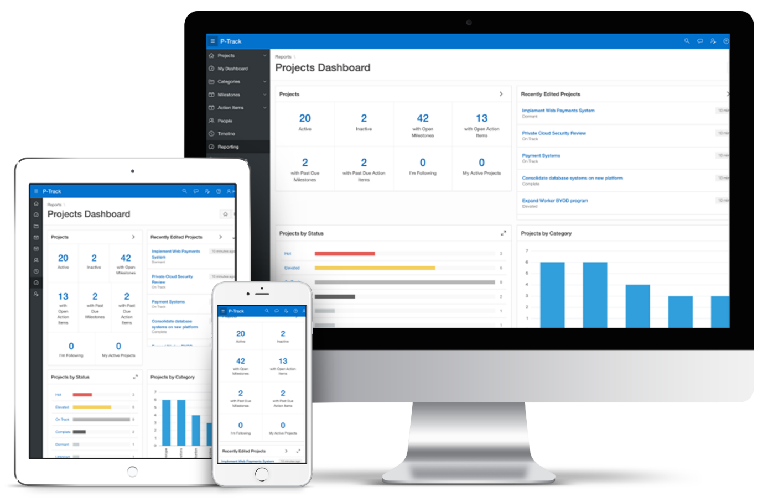
APEX – Distinguishing Characteristics
User Interface for Any Device
Modern, intuitive, accessible UI for any device fully customizable and responsive apps

Slide 9

No-Cost Feature of the Oracle Database
No-cost fully supported feature
Any number of apps, developers & end-users
Specialized Oracle Support Team
Versions: 12c, 18c, 19c, 21c
All DB editions: XE, SE2, EE
Easy to install on-premises
Included by default with all editions of Oracle database
Download latest release from
apex.oracle.com/otn

Slide 10



APEX Architecture
Data Schemas
APEX Engine
SQL & PL/SQL
JDBC
HTTP(s)
Oracle REST Data Services
(Weblogic, Jetty, Tomcat)
Oracle Database (Pluggable or Dedicated, 12c or Above)
Zero latency database data access Dynamically driven by APEX metadata
No Application Logic Converts HTTP to database API calls
Browser
Mid Tier
Database Tier

Slide 11
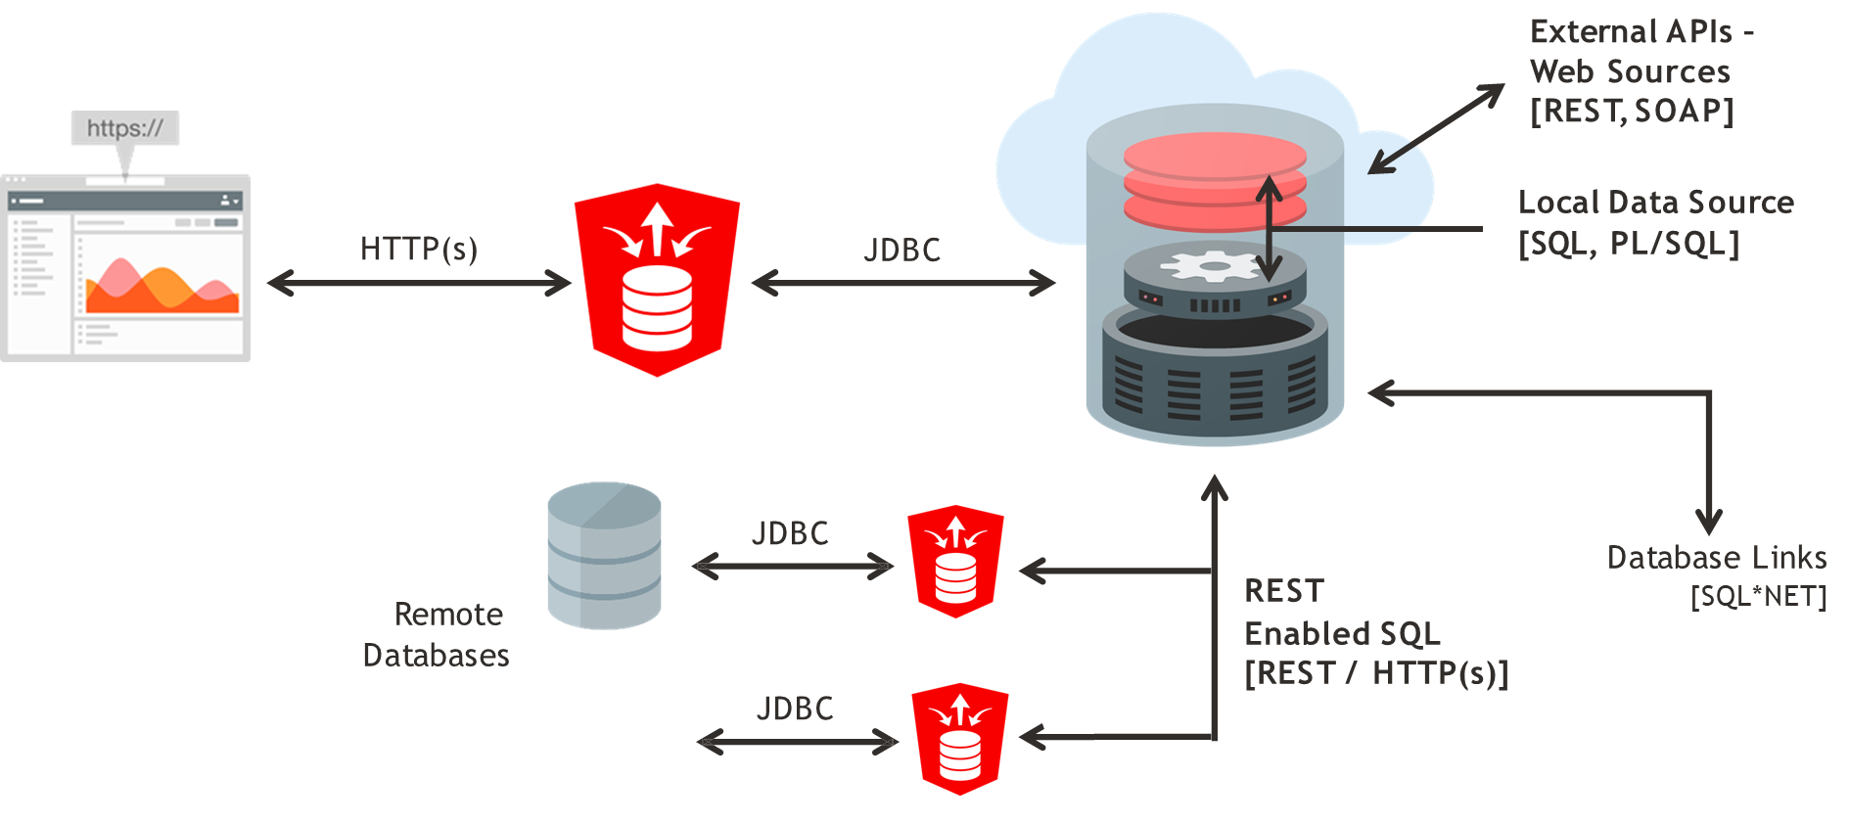
APEX Data Sources

Slide 12
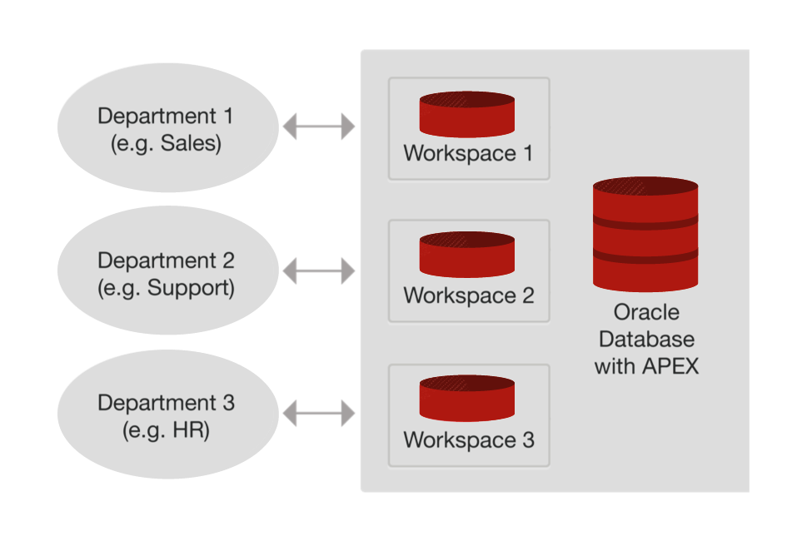
Single Database Instance / Multiple Workspaces
Workspaces used to define application definitions/schemas hold data
Many-to-many relationship between Workspaces and Schemas
Instance Administrators manage the environment and schema access
Departments can request more space, and access to a new schema
For example, Oracle’s internal-only service apex.oraclecorp.com has over 5,000 Workspaces, covering every line of business in Oracle

Slide 13



Development / Deployment Options
Local
Install on stand-alone laptops using Oracle Express Edition (XE) or full database version
On-Premise
Typically run by the IT Department
Cloud
Deploy Internet applications
IT generally both production operations service, and a service provider
Leveraged for fast application development, user acceptance and training
Simply upgrade APEX to the required version
Departments responsible for application development
Prototyping & Proof-of-Concept
Consulting companies develop for deployment on customer premise
Can work completely disconnected
Browser based application development framework enables efficient development & deployment Shoot someone a URL – Check this out – Application Development

Slide 14
Use Cases

Slide 15



Transform Your Spreadsheets to Web Apps in Minutes
Features
Drag and Drop an XLS, CSV, XML, or JSON file
Create table in Autonomous Database
Upload data into new table
Create App based on new table
Solutions
Single source-of-truth
Send out a URL not a file
Secure, scalable, multi-user app
Extend with Charts, Calendars, Validations, and more

Slide 16


Rapid Application Development
Build new business and productivity apps
Features
Build apps in days / weeks not months / years
Use powerful wizards to create fully featured apps
Easily modify to meet changing requirements
Rapidly iterate to production-ready app
Low-code capabilities allow non-IT professionals to also build or help build apps
Solutions
Opportunistic
Simplistic, tactical apps to meet immediate need
Webify paper processes
Generally developed by one or two people

Slide 17


Modernizing Oracle Forms
Features
APEX is the natural evolution of Forms
Both based on SQL and PL / SQL
Re-use DB packages, procedures, functions
Easily train Forms Developers into developing with APEX
Solutions
Proof-of-concept using subset of Forms apps
Organization-wide apps, rather than back-office
External apps for customers / partners
Mobile-first apps
Net new requirements

Slide 18

Extending Enterprise Systems
Features
Extend ERPs and other enterprise software
Provide organization-specific dashboards
Improved workflows
Fill gaps
Solutions
Meet non-standard requirements
Optimize common business functions
Enhance data capture
Integrate disparate data sources
See: Extend E-Business Suite using APEX - Official white paper

Slide 19
APEX Components

Slide 20

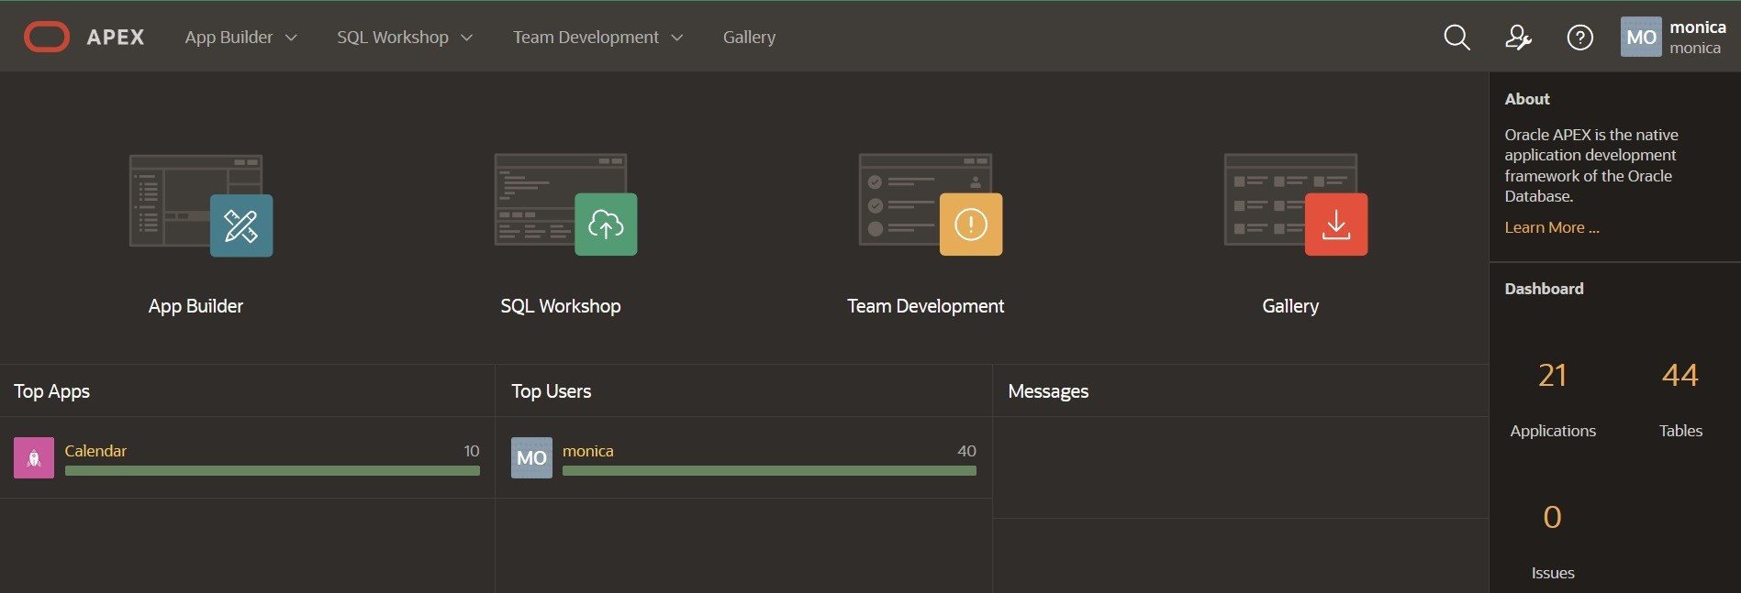
APEX – Home Page
Comprehensive Development IDE, Web Application Development, and SQL Database Development

Slide 21
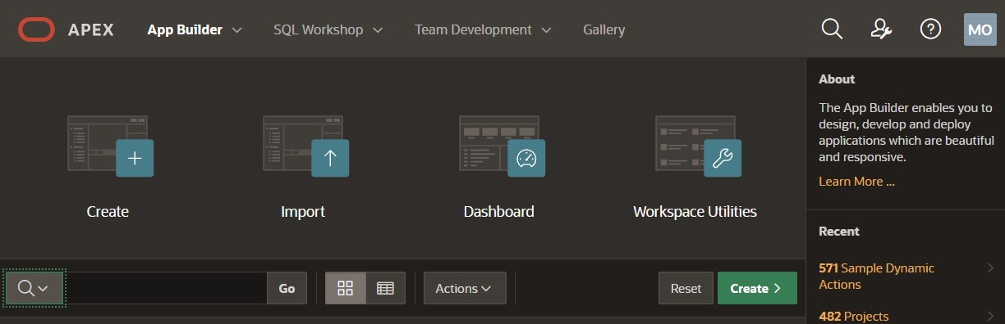
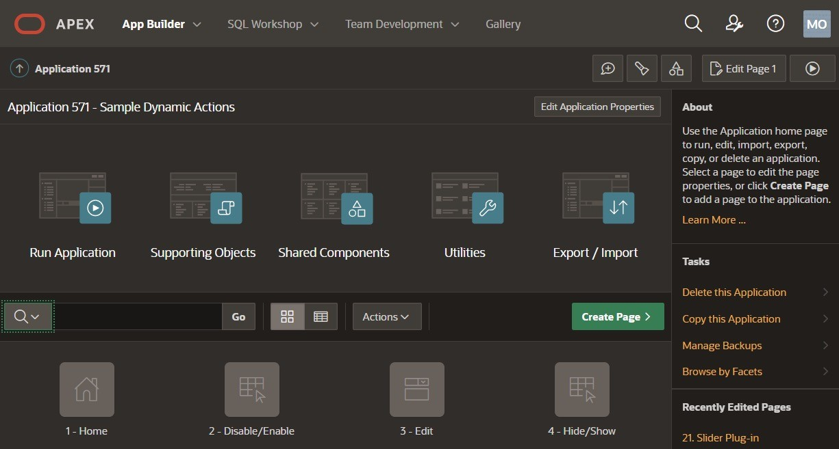
APEX – App Builder
Integrated Development Environment (IDE) with Application Development Graphical "Page Designer" Features tight SQL and PL/SQL integration

Slide 22
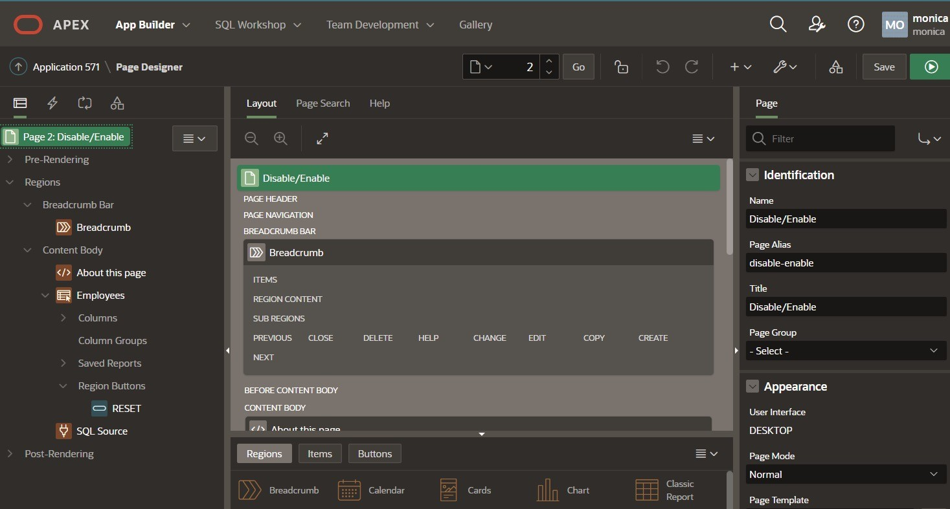
APEX – App Builder – Page Designer
Notes:
Multiple trees to view the page components
Visualization of the page within the Grid Layout, and associated Gallery, allowing you to drag and drop components
Update multiple attributes without leaving the page in the Property Editor
Advanced Code Editor for defining SQL, HTML, CSS and text sections
Highly configurable user interface:
Customize and refine view of page specific to current focus
Slideable panels
Drag and drop tabs

Slide 23
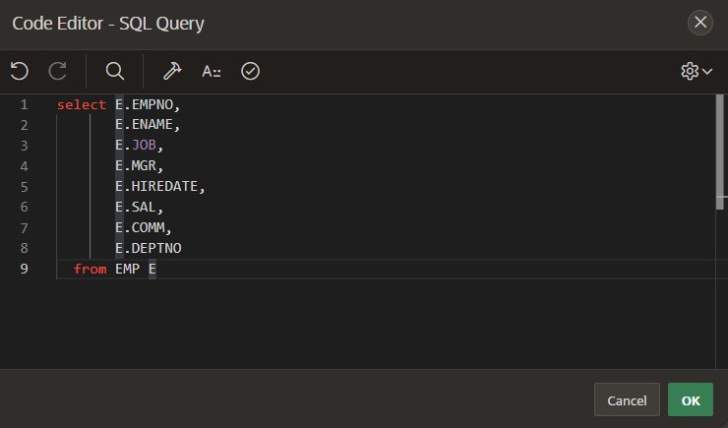
APEX – App Builder – Code Editor
Notes:
Syntax Highlighting
Undo / Redo
Find/Replace
Auto completion
Code validation
Used in Page Designer, Component View
and SQL Workshop

Slide 24
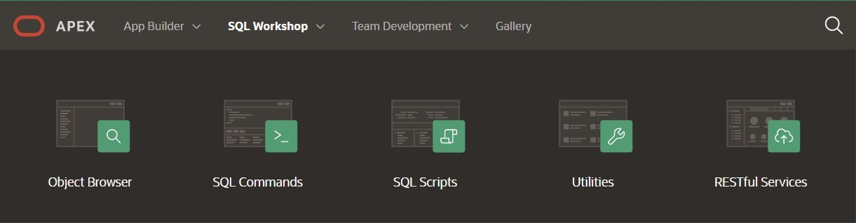
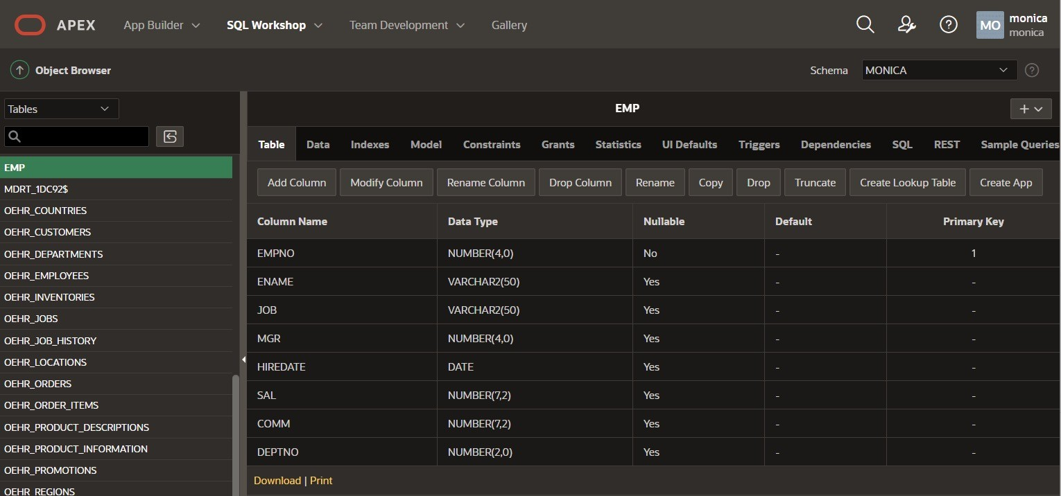
APEX – SQL Workshop
Browser based maintenance of database objects and data Designed to meet application developers’ needs, especially in hosted environments

Slide 25
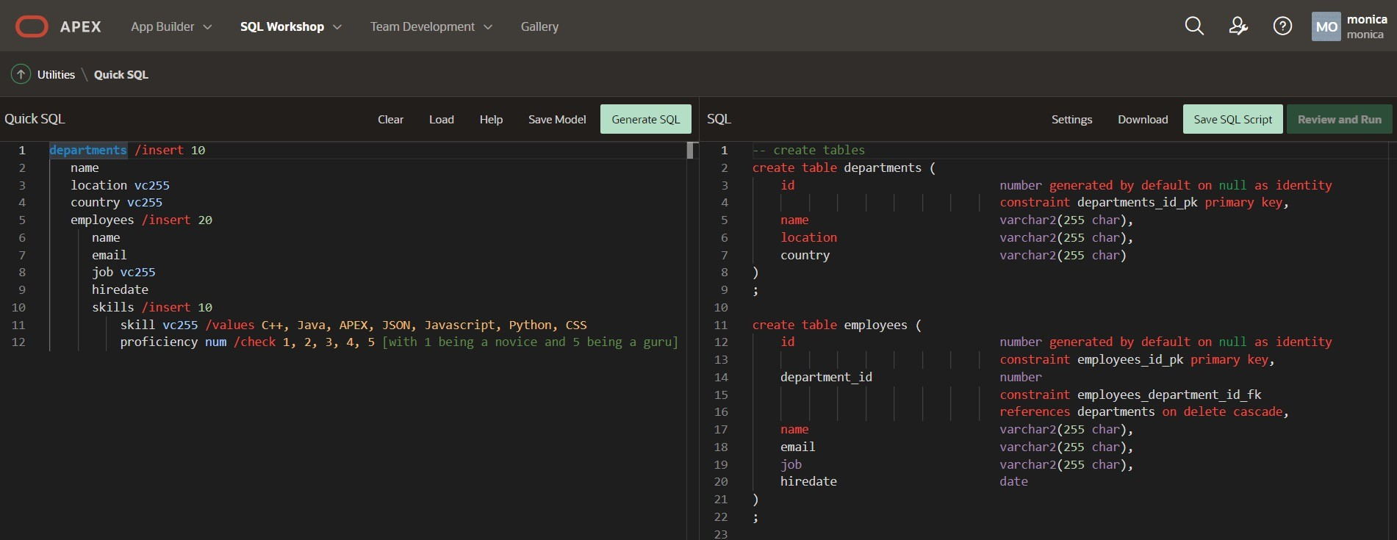
APEX – SQL Workshop – Quick SQL
Rapidly design and prototype data models using a markdown-like shorthand syntax that expands to standards-based Oracle SQL.

Slide 26
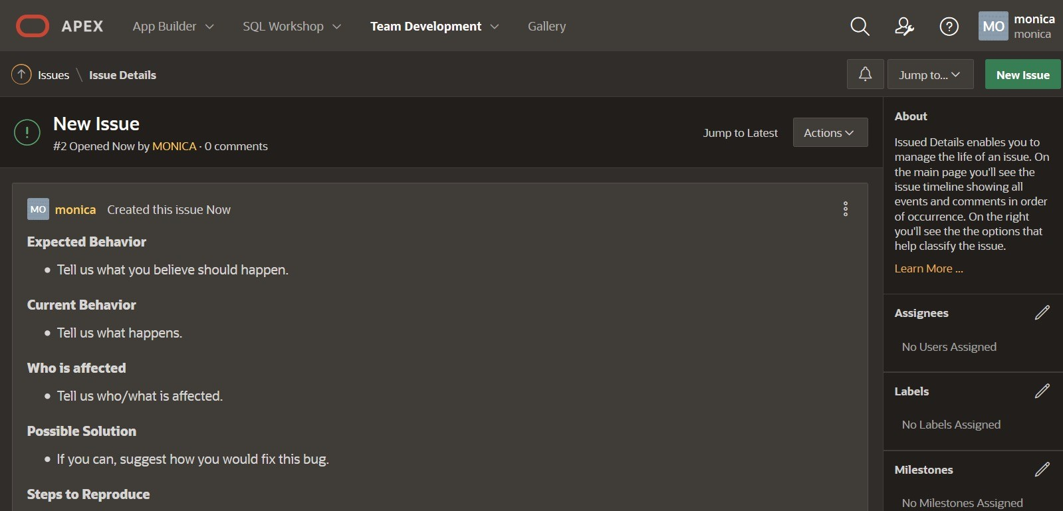
APEX – Team Development
Team Development has been reimagined as a new and more flexible way to work with colleagues and keep track of tasks, features, bugs and feedback.

Slide 27
APEX Features

Slide 28
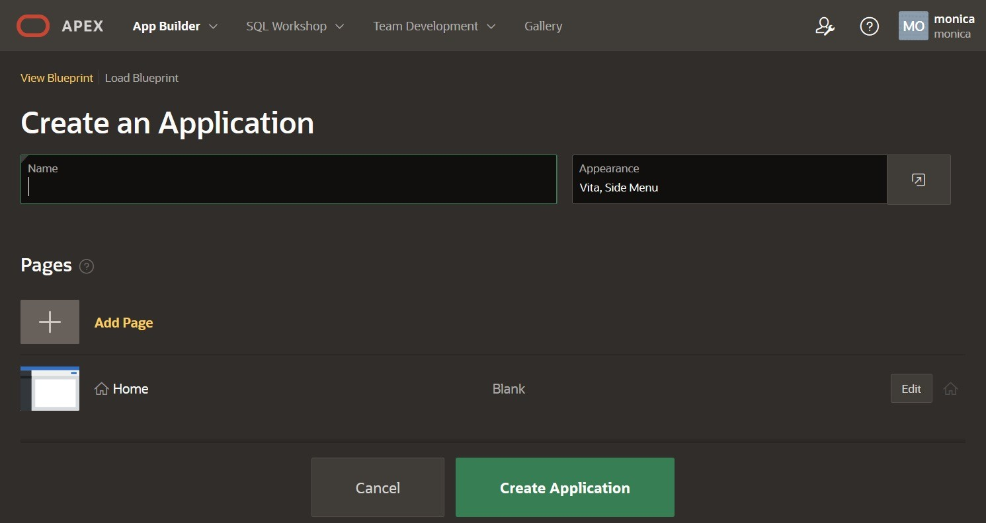
Create Application Wizard
Simple, modern wizard for creating pages.
Allows creation of numerous page types including Dashboards, Master-Detail, etc.
Supports adding common frameworks or "Features" when creating an application such as access control, activity reporting, theme selection, and more
Customize user interface options such as Theme Style, application icon and page icons

Slide 29
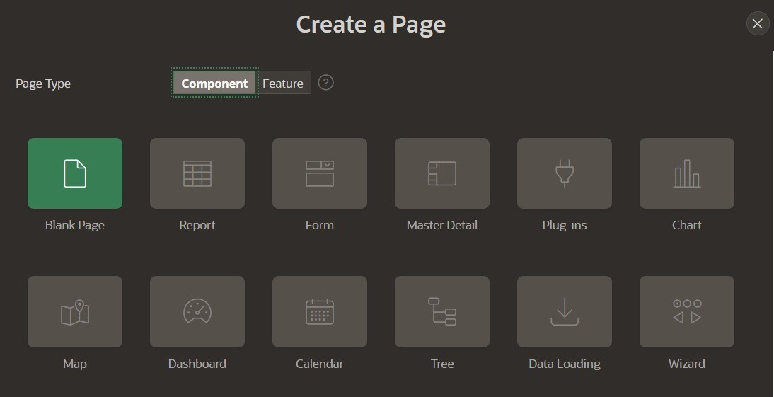
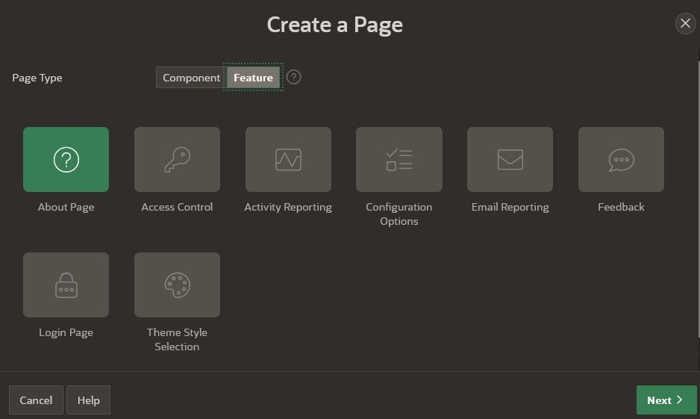
Create Page Wizard
Simple, modern wizard for creating individual pages in an existing app.
Allows creation of more advanced pages such as Dashboards, additional Master-Detail page types, List View, mobile first reports, and more.
Supports adding common frameworks or "Features" to an existing application such as access control, activity reporting, theme selection, and more

Slide 30
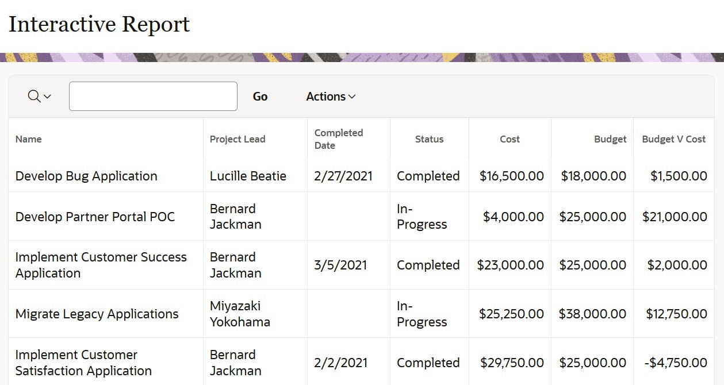
Interactive Reports
Powerful Reporting capabilities → End-user customizable

Slide 31
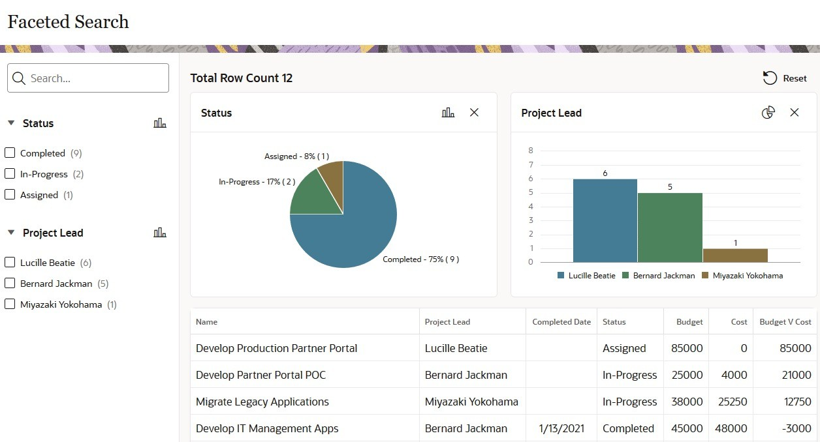
Faceted Search
A powerful way to filter and display your data.
Faceted Search will make it easier for your users to find the data they want.

Slide 32
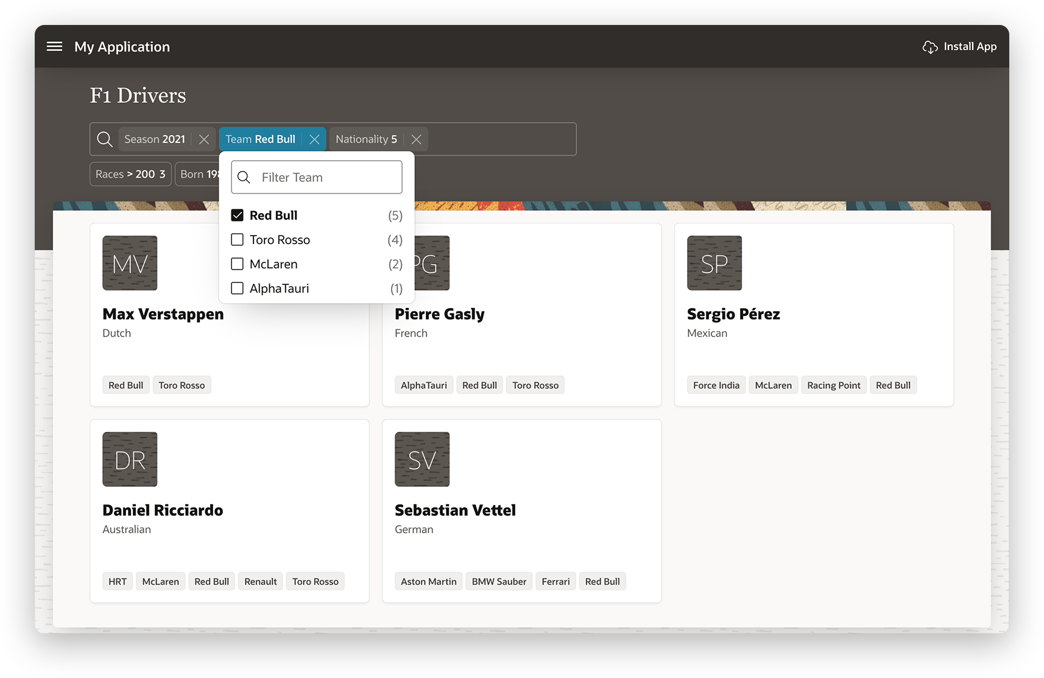
Smart Filters
New search component that allows users to quickly narrow data down with filters suggestions or search terms
Features a powerful Search Bar that provides built-in auto-complete for your filters, supports searching for multiple terms, and provides easy keyboard navigation.
Filters are evaluated against your data and displayed below the search bar as chips

Slide 33
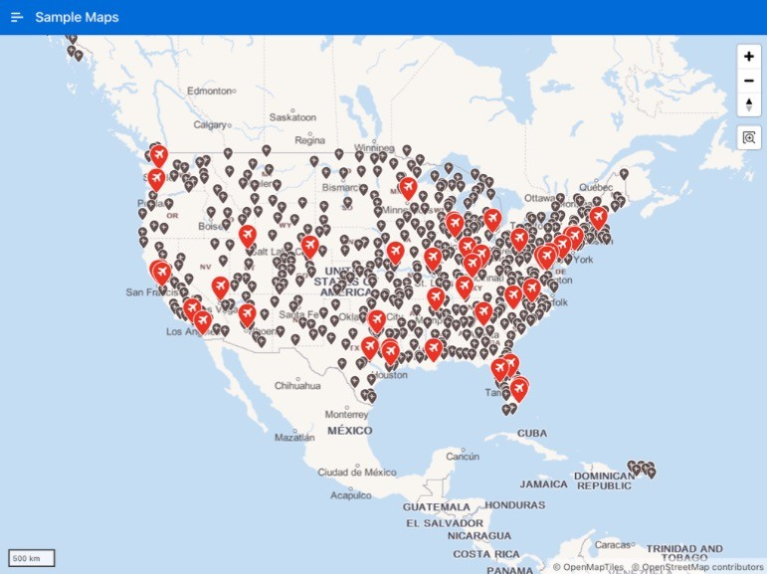
Maps
The native Map component allows you to add powerful, feature rich, and interactive maps.
Powered by Oracle eLocation Service so it is ready to use, no API Key required.
Create maps with layers for points, lines, polygons, 3D polygons, and heat maps.

Slide 34
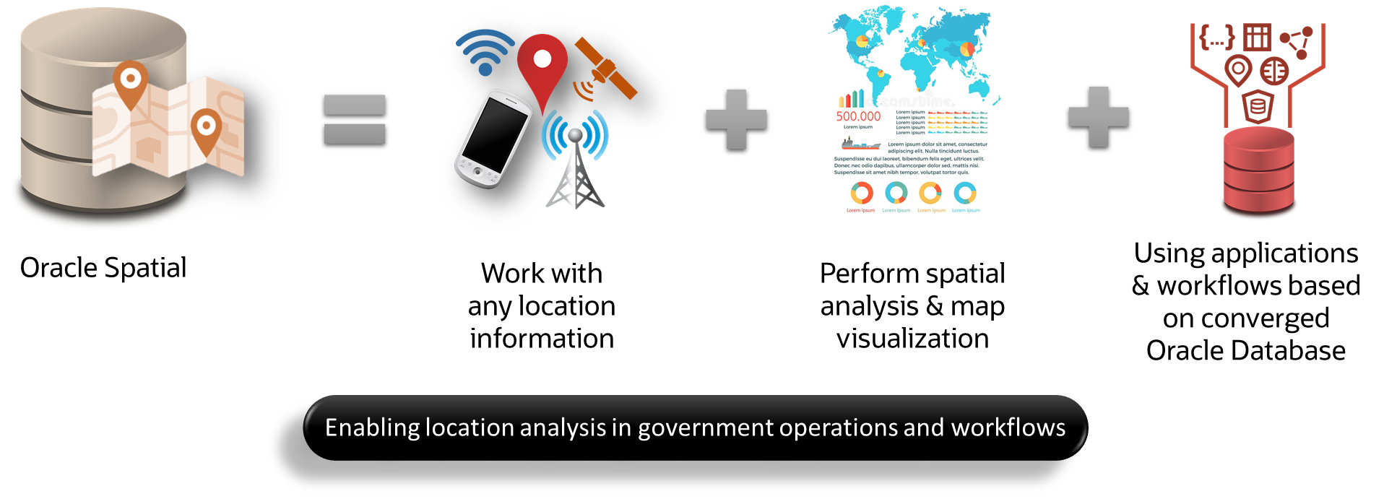
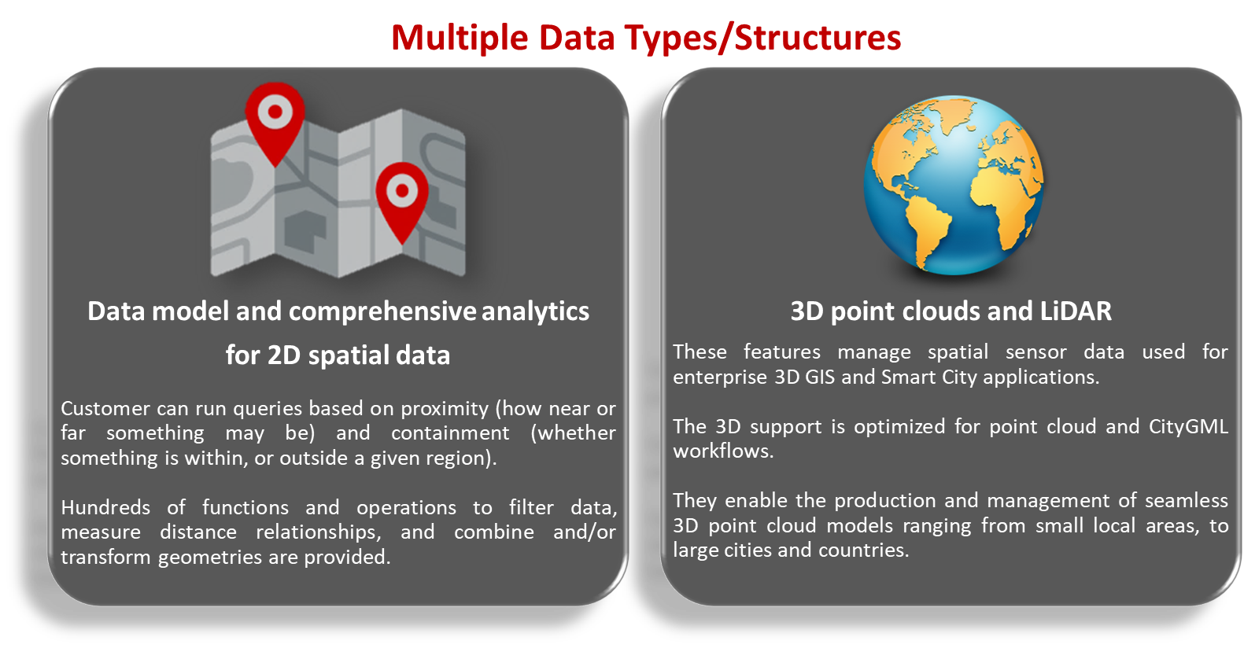
Maps

Slide 35
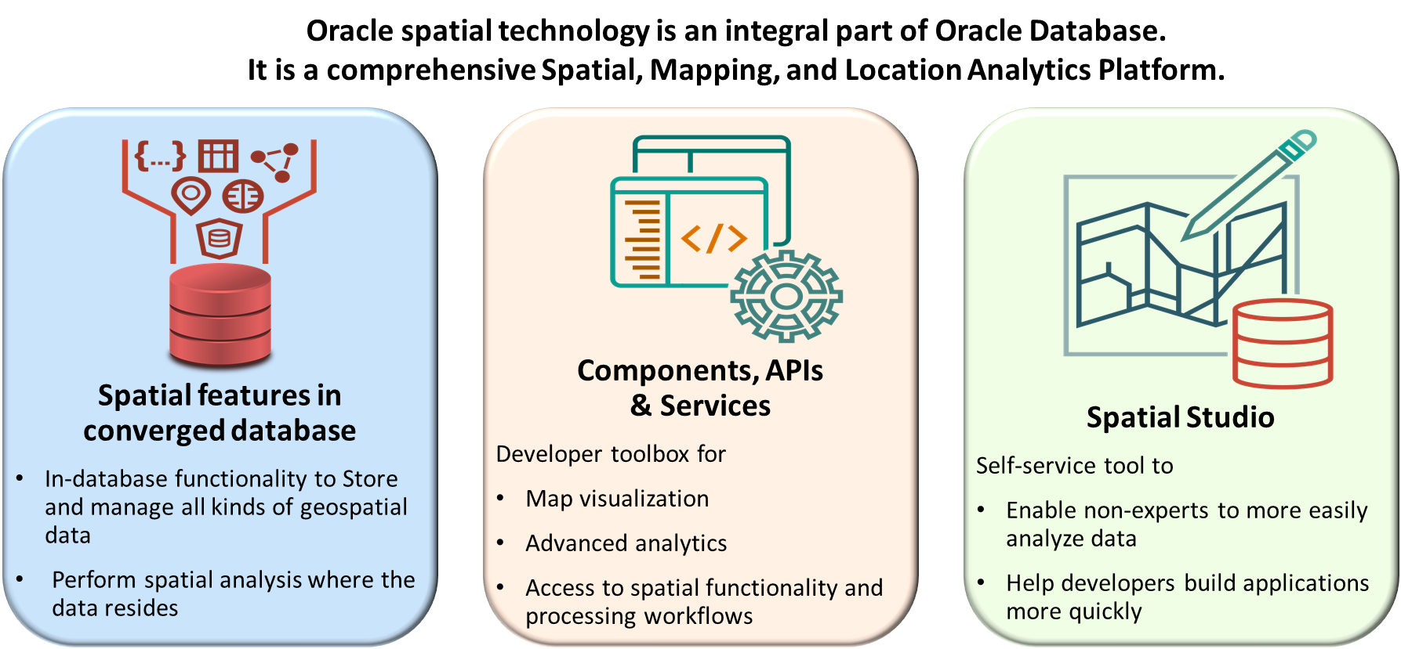
Maps

Slide 36
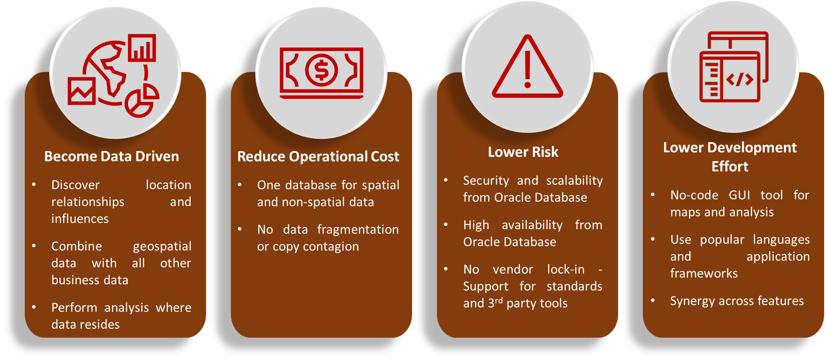
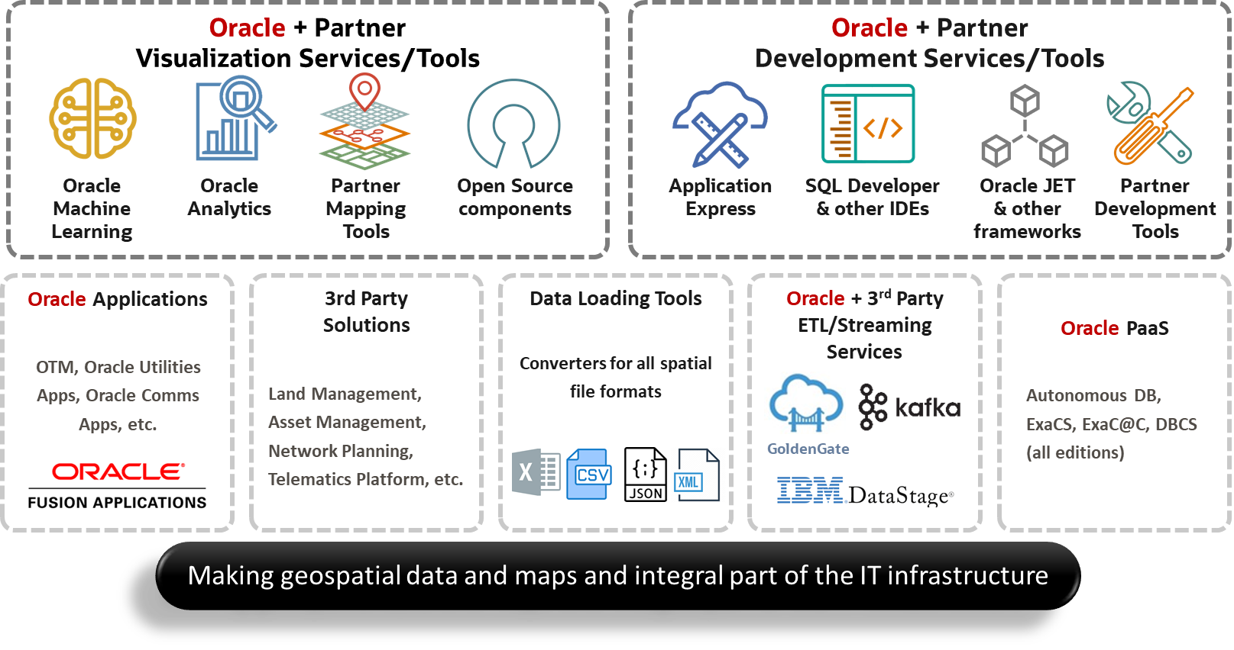
Maps - benefits

Slide 37
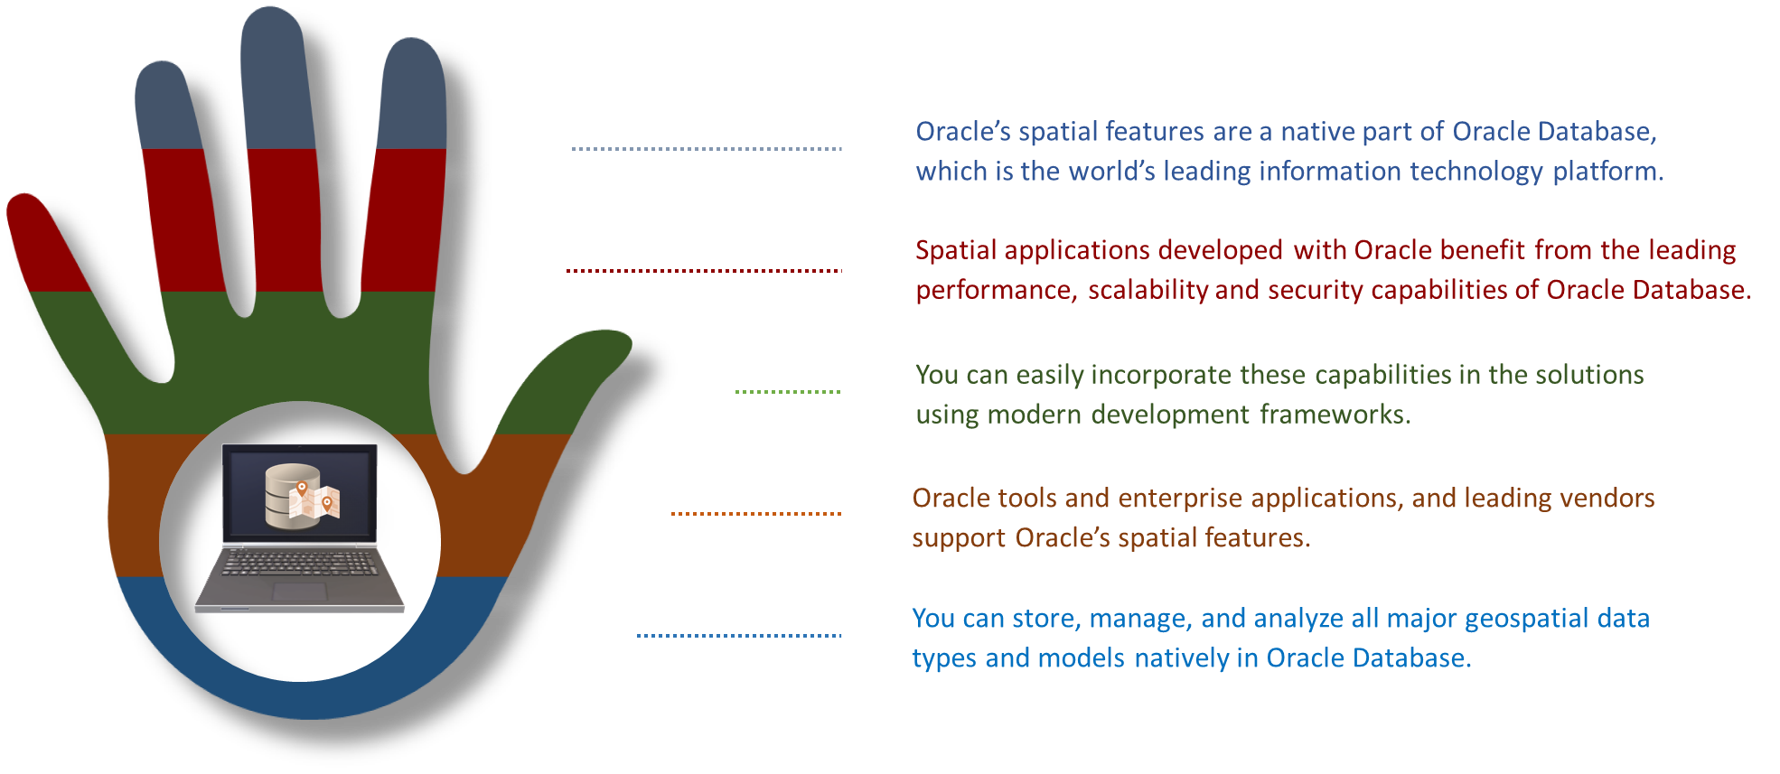
Maps

Slide 38
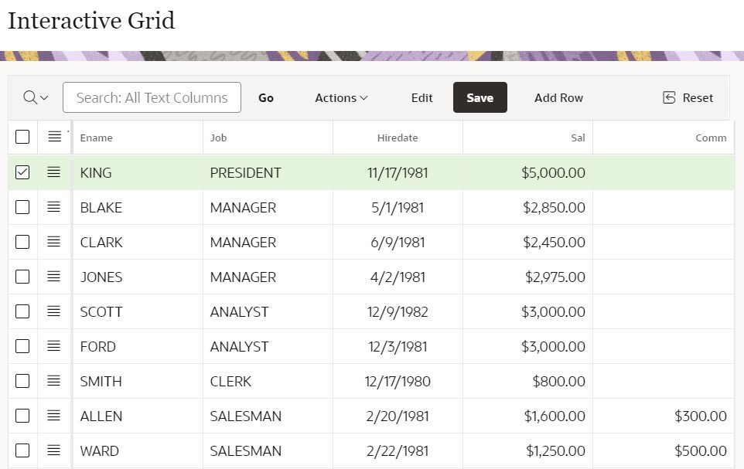
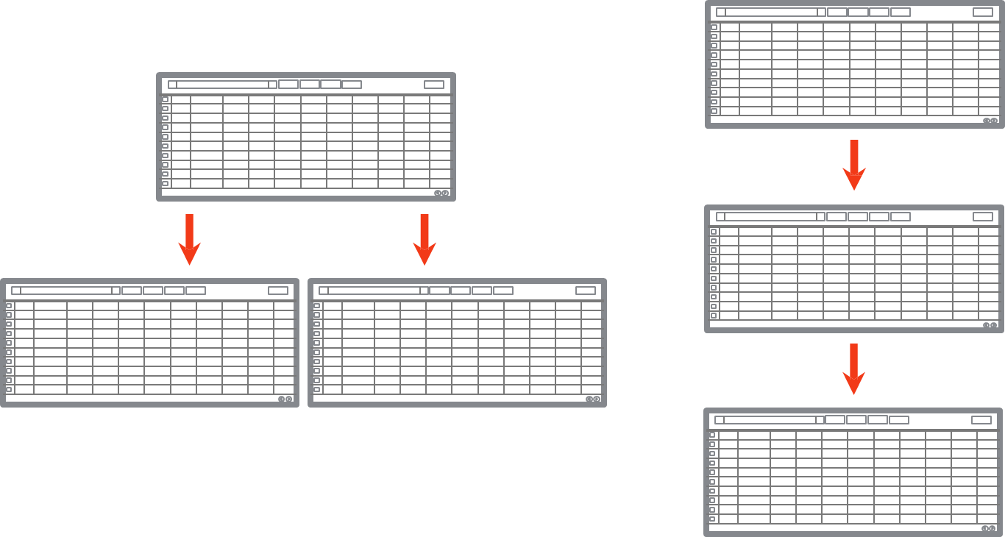
Interactive Grid
Modern, rich & interactive multi-row editing component
Use of existing Item types
Declarative support for Cascading LOVs and Dynamic Actions
Upgrade utility for Tabular Forms
Master Detail / Detail
Master Detail Layout – N-levels wide or deep

Slide 39
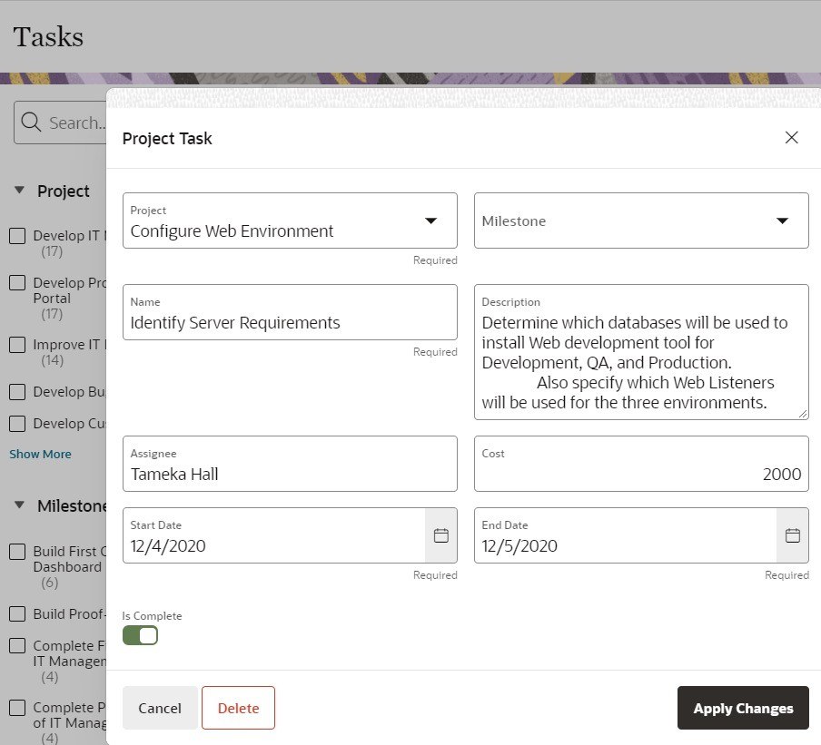
Modal Dialogs
Readily switch between normal, modal, and non-modal page mode
A modal dialog is a stand-alone page, not a region on a page
Any page be created as a dialog page
Supports all the functionality of a regular page, including computations, validations, processes, and branches

Slide 40




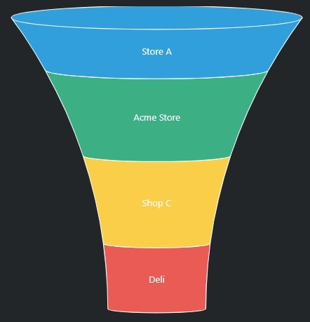
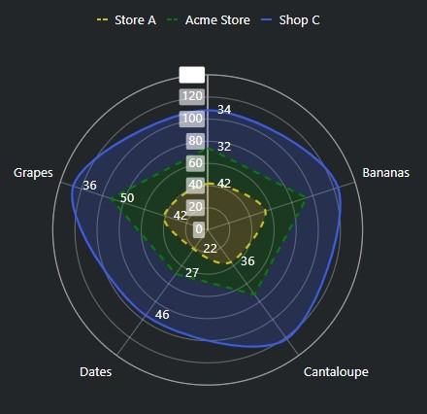
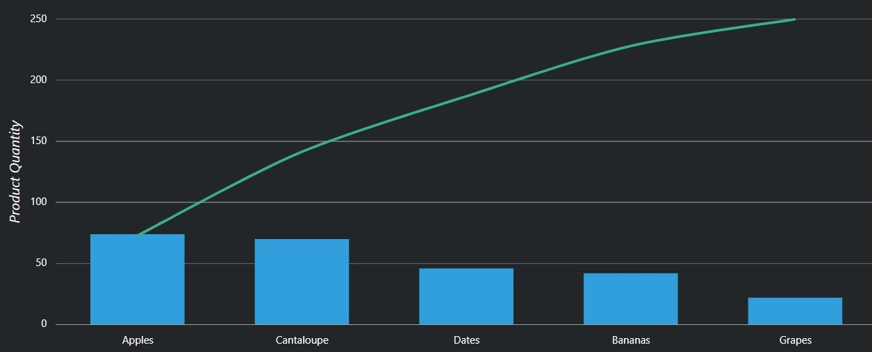
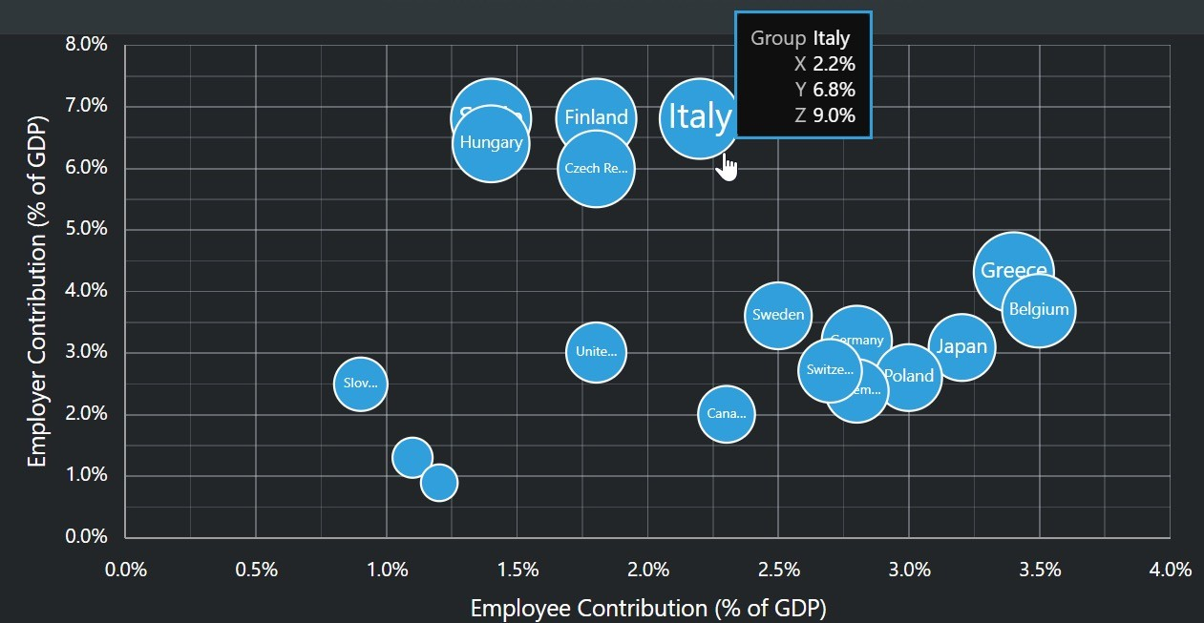



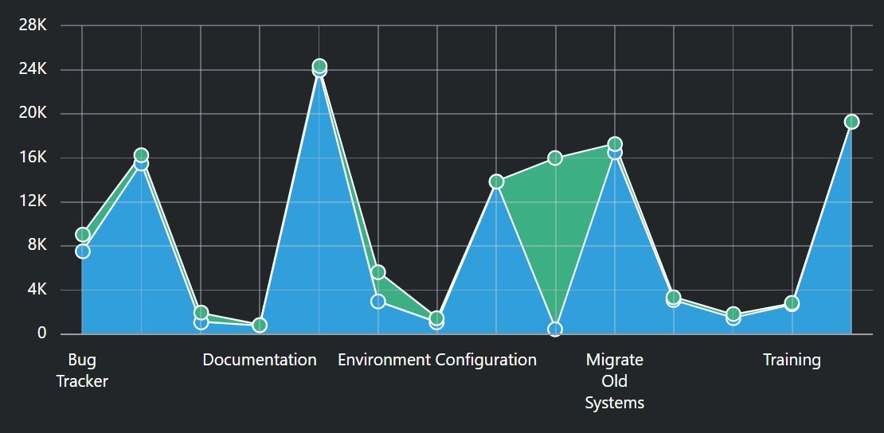
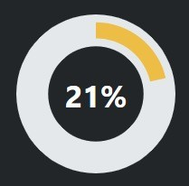
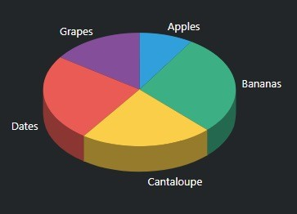

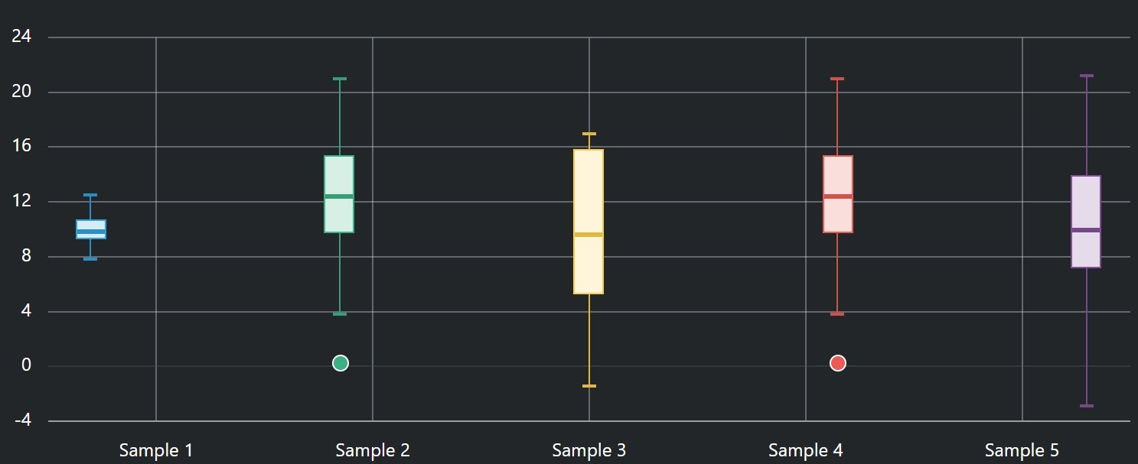

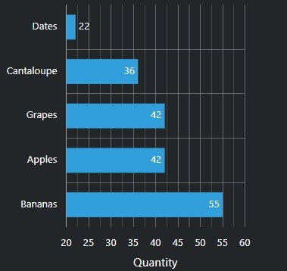

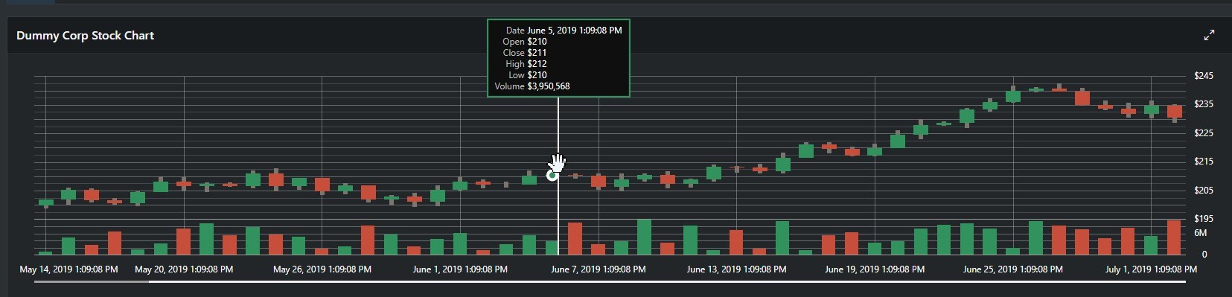
Charting Engine
Declarative support for Oracle JET Data Visualization Components
Based on Oracle JET Data Visualization Components
Oracle JET (JavaScript Extension Toolkit) is open source
JavaScript-based solution, data being provided in JSON format
Highly Customizable
Using 'JavaScript code' to provide function to be called when chart is initialized
Using Dynamic Actions to add interactive behavior
Built-in Accessibility Support
Built-in Responsive Design Support

Slide 41
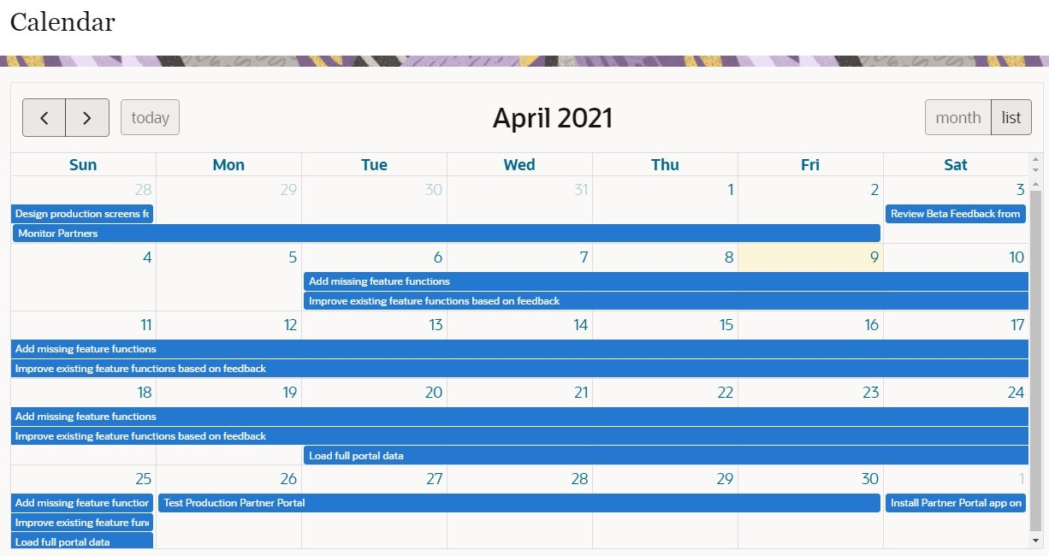
Calendar
Different views, drag and drop capability

Slide 42
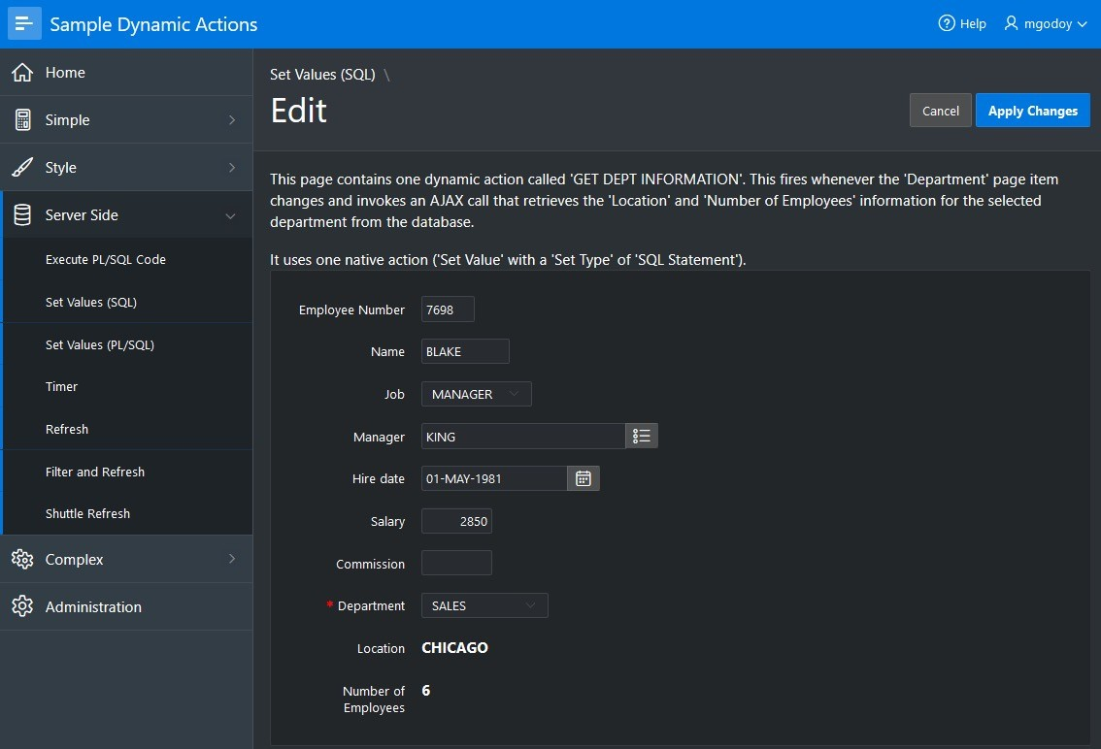
Dynamic Actions
Declaratively define rich client-side interactivity without writing JavaScript or AJAX

Slide 43
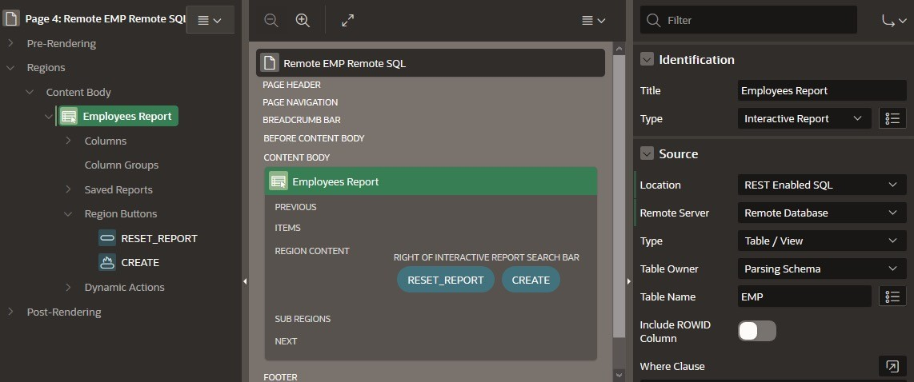
REST Enabled SQL Support
Create and maintain References to REST Enabled SQL Instances (Oracle REST Data Services) in Shared Components: A name, Endpoint URL, and Authentication information
Use a REST Enabled SQL Service and therefore a remote Oracle database as the Data Source for Oracle APEX components like:
Classic Reports, Interactive Reports
Reflow Report, Toggle Columns Report
Tree Region, JET Charts
CSS Calendar
PL/SQL Process

Slide 44
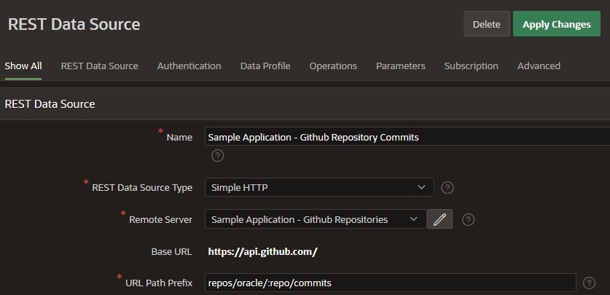
Consuming External REST APIs
REST Data Sources are a declarative method to define references to external REST APIs and generic JSON data feeds.
REST Data Sources store additional metadata about how to parse response data and map it as a virtual table with rows and columns.
A module can contain one or many operations which are the references to a concrete external web service.
Create and maintain REST Data Sources in Shared Components.
Use as data sources for Oracle APEX components such as:
Interactive Report, Classic Report
JET Chart, CSS Calendar
Tree Region, Reflow Report, Toggle Column Report
Post Processing SQL modifies data before being processed by an Oracle APEX component:
Apply SQL functions, aggregations, join to local tables etc.
Avoid unnecessary HTTP requests by using Caching

Slide 45
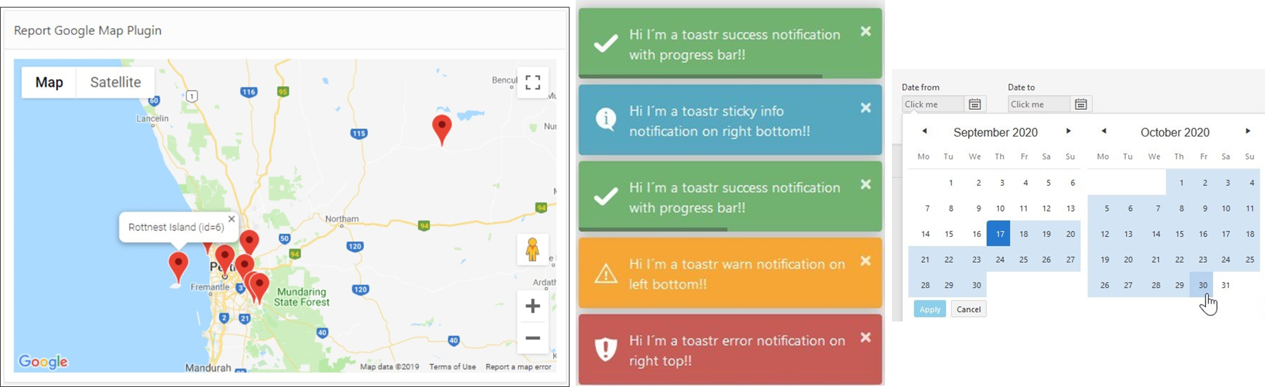
Plug-Ins
Extend applications with custom components such as items and regions
apex.world/ords/f?p=100:700

Slide 46

Oracle APEX - Summary
Aligned with industry trends: Strong support for HTML5 development frameworks, Modern & responsive CSS3 UI, integrated JavaScript libraries, Browser-based, self-service provisioning, flexible development and deployment including cloud services.
Used by real customers for real applications: Used for both opportunistic and mission critical apps that service millions of users.
Consistent with Oracle developers' skill set: SQL, PL/SQL, Oracle Database.
Proficiency in the Oracle database easily translates into an ability to develop web applications.
Well Established Product : First released in 2004
Most powerful Low Code Application Development Platform: Allows developer to focus on solving the business problem and delivering superior solutions, with less time and effort spent on mundane and repetitive lower-level coding.
Oracle APEX
Best tool to implement Geospatial, analytical, and API-based requirements
Continually growing: Oracle install base is adopting Oracle APEX for increasing numbers of projects and is increasingly an approved corporate IT standard.
Always Free: You never pay for Oracle APEX, whether on-premises or cloud, no matter how many users or workload is there

Slide 47
More About APEX
Primary site APEX apex.oracle.com
Shortcuts APEX apex.oracle.com/shortcuts
Community apex.oracle.com/community
Blogs blogs.oracle.com/apex
APEX on Autonomous apex.oracle.com/autonomous
Database Cloud Services cloud.oracle.com/database
Oracle APEX Education apex.oracle.com/education

Slide 48

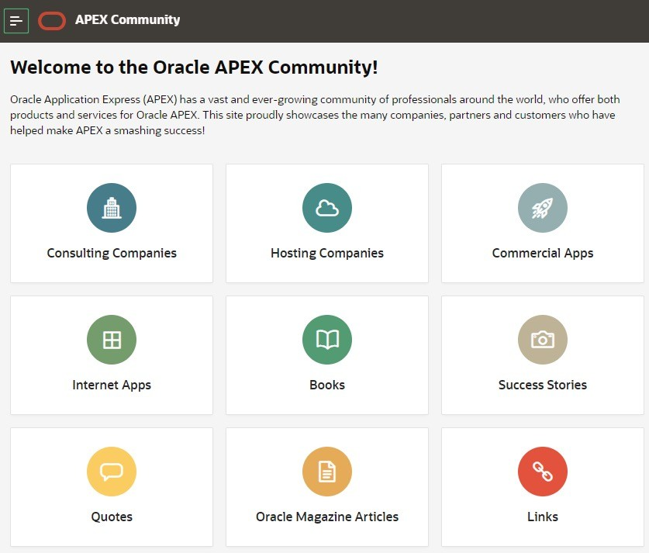

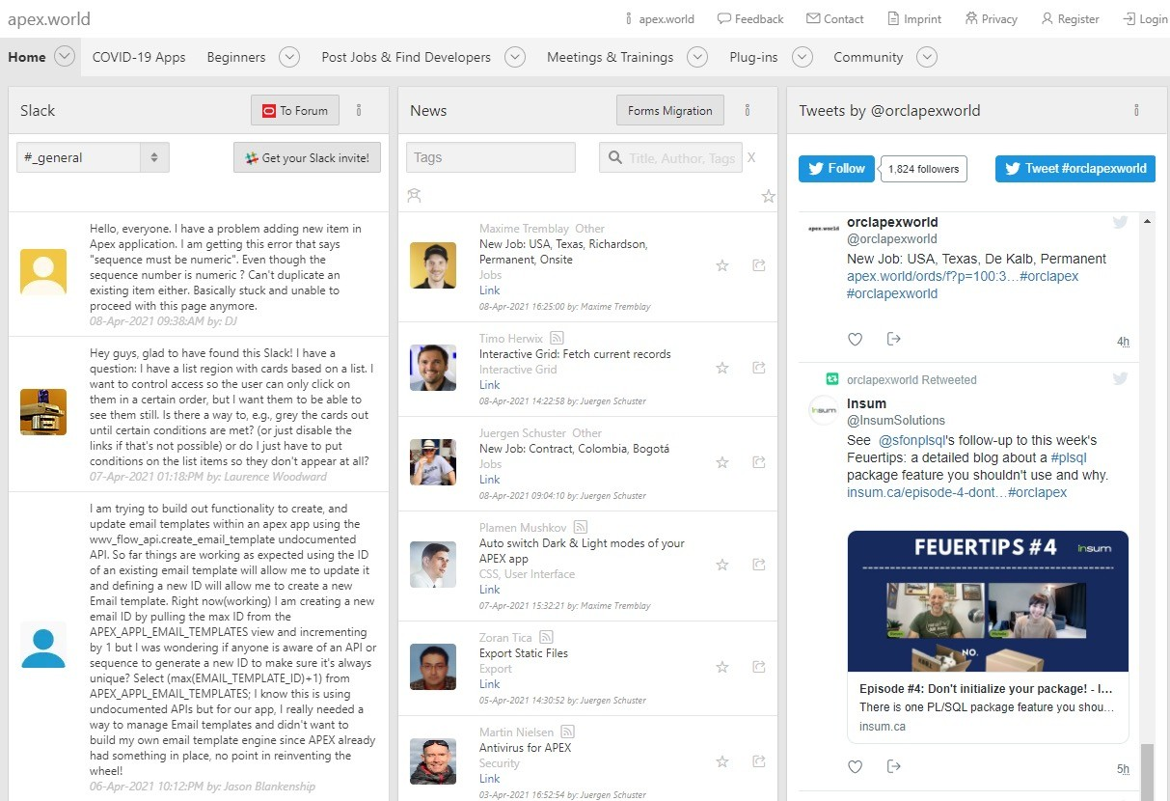
Oracle APEX Community and APEX World
Over 500,00 developers worldwide
Estimated from support requests, downloads, conferences, discussion forum activity
More than 100 active bloggers
odtug.com/apex
apex.oracle.com/community Consulting companies, books, success stories, quotes, commercial apps
Community-authored site providing:
Plug-ins
Slack discussion channels
Twitter feeds
News
Jobs
Conferences
Meetups

Slide 49
Thank you!
49

